Slide 1
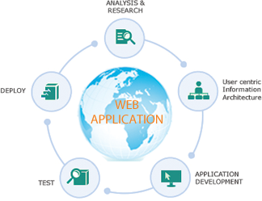
YouRS (YouTube v3 Ranking System)
Presented by
Peregrine Falcons Group
Sravani Punyamurthula
Vaishnavi Aeinampudi
Leela Naga Devi Gajula
Vinaya Podduturi

Slide 2
Introduction
YouRS is a web application which is implemented based on Adknowledge Use Case “YouTube v3 Ranking System Based On Object Search”
Our primary functionality is retrieving videos utilizing YouTube v3 API and sorting them based on our Ranking algorithm
Additional functionality we provided is retrieving videos based on ontology search using wiki data API

Slide 3
Technologies used
YouTube v3 API , Wiki data API
Microsoft Azure - Cloud platform to build, deploy, and manage applications
MVC5 architecture – Visual Studio Professional 2013
Ajax – Call for web services and rest API’s
C# , JavaScript – Programming languages
HTML , CSS, Bootstrap – User Interface design
SQL Server – Database

Slide 4
YouRS Architecture
http://srecorder.com/
Response
Controller
Model
HTML’s and Java Scripts
User
Routing Engine
Request
YoutubeV3 API
View

Slide 5
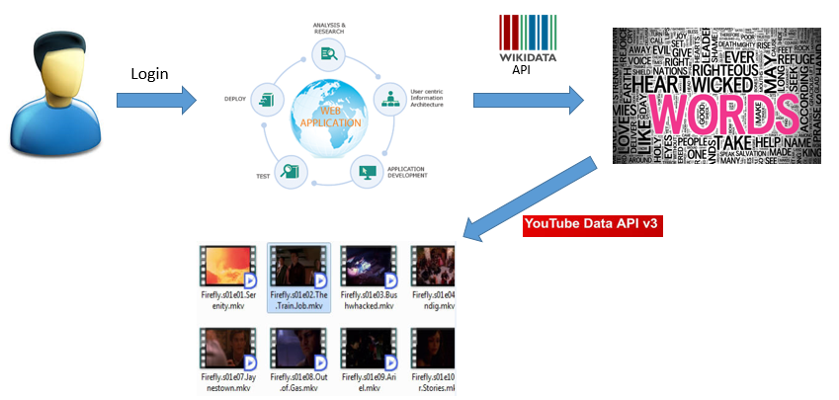
Use Case Scenario

Slide 6
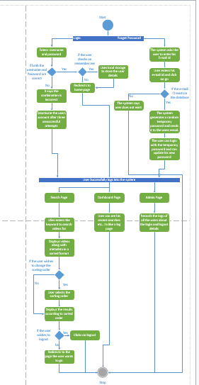

Slide 7
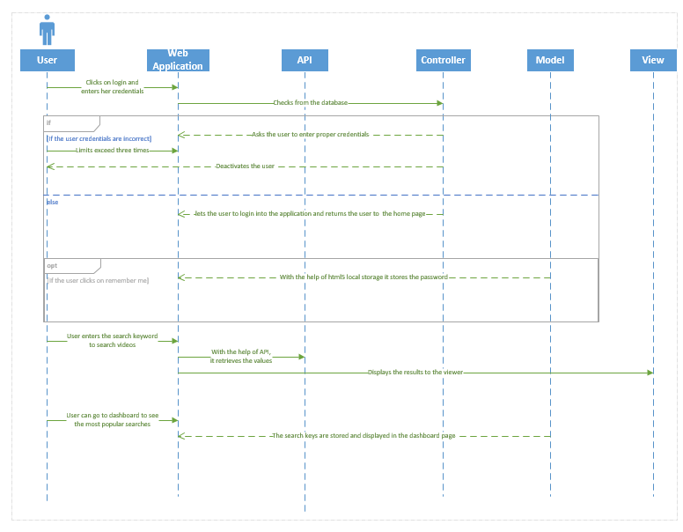

Slide 8
Goals achieved
User Login activity is securely implemented
Login and Logoff
Forgot Password
Remember Me
Deactivate users after three consecutive login failures
Home page
Keyword search for videos
Lists videos with thumbnails
Displays Meta data for videos( likes, dislikes, views, favorites, comments, author, published at)
Allows Sorting based on Ranking algorithm
Allows Sorting based on the metadata

Slide 9
Goals achieved
Admin page
Displays frequent login users
Also displays normal users and idle users
Dashboard page
Displays recent searches of user sorted by popularity
Ontology search page
Takes wiki data id as input and fetches the respective keyword from wiki data
The keyword retrieved from wiki data is given as input to YouTube v3 API
Get the videos based on the keyword and sort them according to metadata
This eliminates the ambiguity (e.g. Golf game and VW Golf car)

Slide 10
Key Features
Microsoft Azure – Cloud platform as IaaS and PaaS
MVC 5 architecture – Framework for building scalable web-based applications using well-established design patterns
Ontology – Implemented using wiki data
User cannot view any pages in the application without login.
Security Tokens – Generated for secure user login when the user checks “remember me”
Ranking Algorithm – sorts videos having more views, more like, more comments and less dislikes.

Slide 11
Testing
Performance testing: Tools used
Firebug
The firebug tool will automatically show us if there are any errors in the JavaScript, CSS or HTML code and request URL’s or XHR requests.
YSlow analyzer
This is a free, open source testing tool that analyzes web pages and suggests ways to improve their performance.

Slide 12
Future Enhancements
Play video without navigation to other page
User can upload video in the dashboard page

Slide 13
Project URLs
YouRS web application URL
http://yt-dashboard.azurewebsites.net/
Youtube URL
http://youtu.be/iOvyu80HzQQ
GitHub URL
https://github.com/vaishnavi5054/YouRS-Hackathon-ASE-/tree/master/YouRS%20PPT-Peregrine%20Falcons

Slide 14
Thank You!
This work was done in fulfilment of the requirements of
Hackathon Spring 2015
AdKnowledge (Case study #01)
http://www.adknowledge.com/
Instructor: Dr. Yugyung Lee
TA: Malathy Krishnan, Mayanka Chandra Shekar, Bharath Viswanadham
CSEE Department, University of Missouri – Kansas City (Spring 2015)

